Slide 1

ETERNA · WEALTH INTELLIGENCE
The Portfolio That
Explains Itself.
Click any number and it tells you what it means, why it matters, and the one thing to do next.
Investor & Board Pitch

Slide 2
What if every number on your
dashboard could tell you what to
DO about it?
Right now, answering that takes an analyst in the room. That doesn't scale.

Slide 3
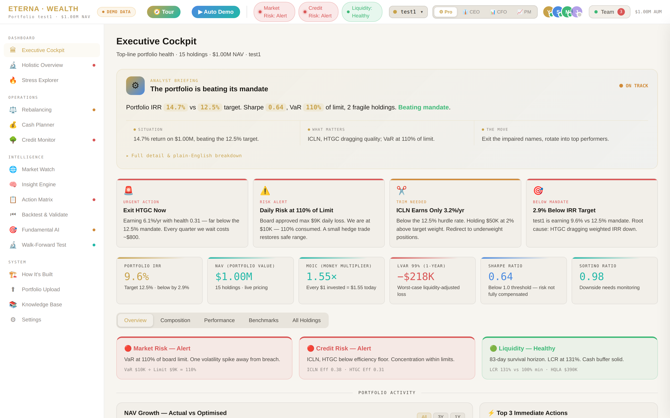
1
This is the Executive Cockpit
Every screen opens with a plain-English analyst briefing — not a wall of numbers. This is the real platform.

Slide 4




2
Click a number — get the story
Whatever you click, the story has the same four-part shape — building from meaning to action.
1
2
3
4
What it is
Why it matters
What's driving it
The action that moves it
Plain English, in context. No jargon.
The stakes — a mandate, a limit, a gap.
The exact holdings responsible, named.
The single next step, spelled out.
It never just shows you the number. It tells you what to do about it — and every story ends in a decision.

Slide 5
3
One portfolio, four lenses
One click reframes the entire platform for whoever's in the room.
Pro
CEO
CFO
PM
The full technical platform
Is the strategy working?
Where does the money go?
What do I trade today?
Every metric, every tool — the complete analyst workspace.
The headline, the risks, and the one decision for the board.
P&L, fees, provisions & liquidity — every dollar accounted for.
Factor exposure, drift & specific buy/sell calls.
Same truth. Nobody has to translate for anybody.

Slide 6
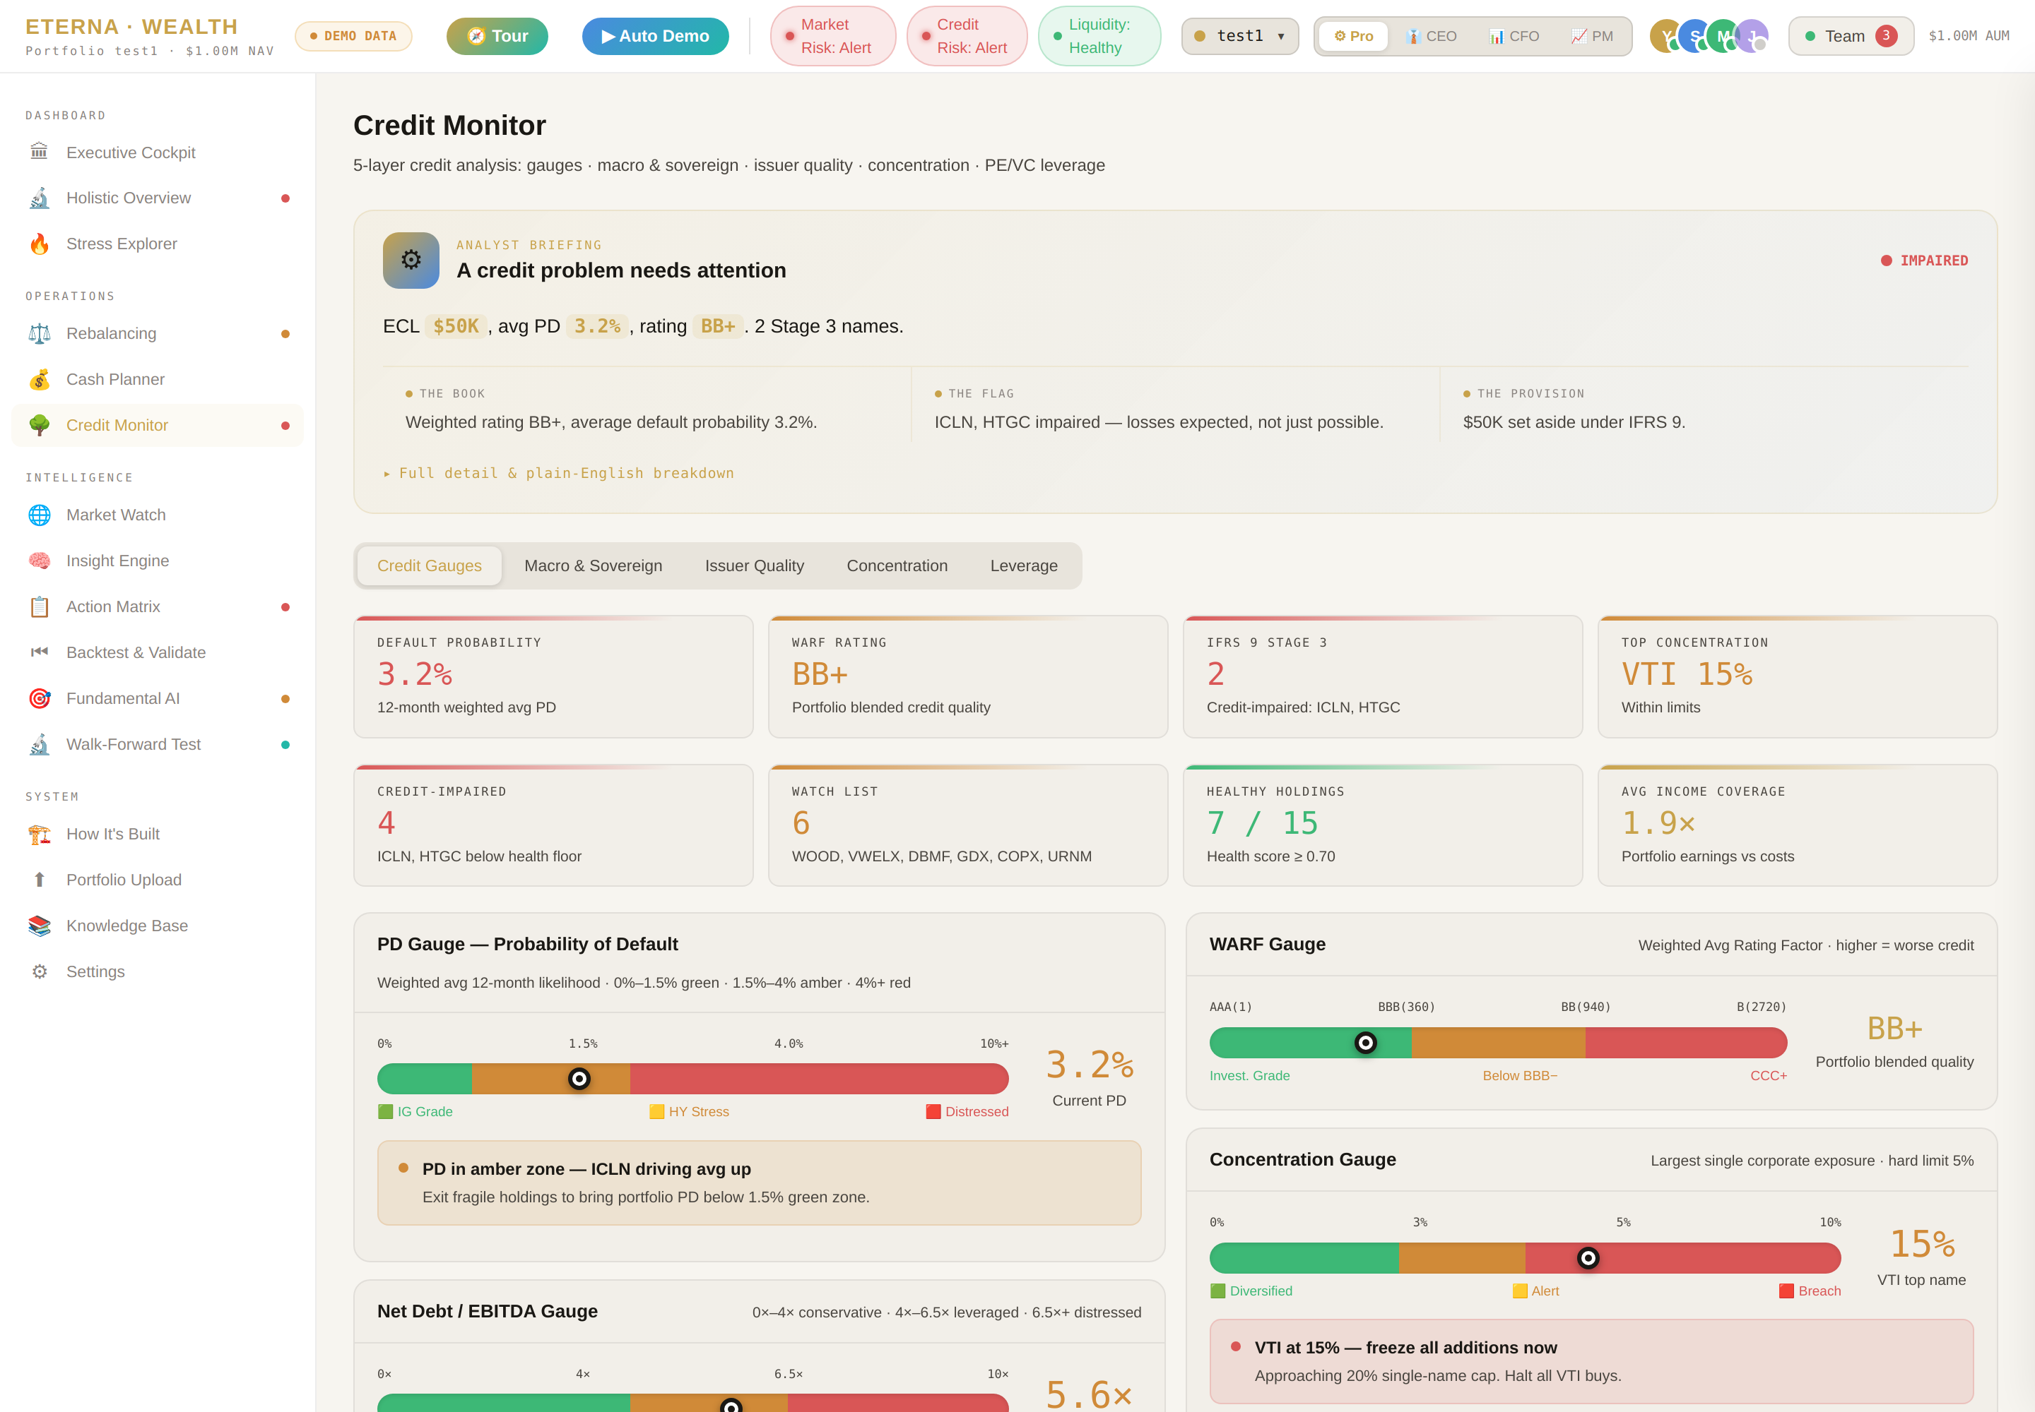

4
Deep analysis, explained simply
Credit Monitor
IFRS 9 credit staging
Default probability, WARF rating, and Stage-3 impairment — computed and gauged live.
Plain-English framing
Every gauge comes with what it means and the action it implies — 'exit fragile holdings to bring PD below the green zone.'
Institutional depth
Concentration limits, leverage, macro & sovereign — the analysis a real credit desk runs.

Slide 7
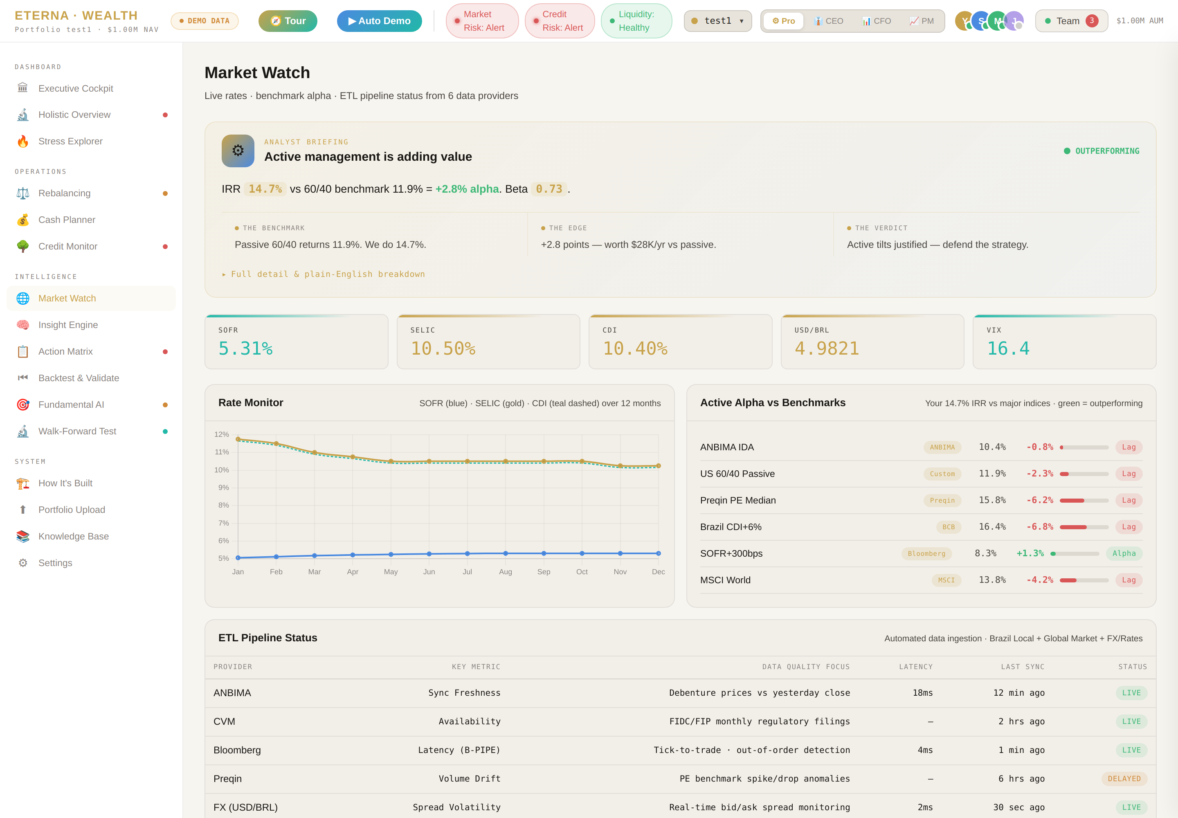
5
Live market intelligence
Benchmark alpha, rate monitoring, and a live ETL pipeline from six data providers — with the same story-first framing on top.

Slide 8


6
It even demos itself
Built-in onboarding that doubles as a hands-free product demo.
Guided Tour
Auto Demo
A spotlight walkthrough highlights each area with a plain-English explanation — new users are oriented in 90 seconds.
One click and the platform runs itself — advancing through the story, switching role lenses, with synced on-screen captions and voice narration.
Perfect for a self-running booth, a recorded walkthrough, or a first-time user — the product sells itself.

Slide 9



7
What this changes
Half a day → one click
Everyone, aligned
A board memo, a risk read, a daily report — work that took an analyst hours is now instant.
Pro, CEO, CFO, and PM act from one source of truth, each in their own language.
Insight without a specialist
Confidence in every number
The platform carries the explanation, so understanding scales to the whole team.
Each figure shows what it means and what's driving it — no black boxes.

Slide 10
ETERNA · WEALTH INTELLIGENCE
Where the numbers
tell a story —
and every story
leads to a decision.
▶ Open the live platform
rkac12288-bot.github.io/AI-Platforms-/eterna-wealth

